Slide 1
Healthcare Stigma Facing Transgender Individuals:
From Access to Policy and Care to Treatment
Wednesday, April 20, 2016
2:00 – 3:00 PM EST

Slide 2
National Coalition for LGBT Health
Created in 2000, the Coalition is dedicated to achieving LGBT health equity
Comprised of leaders from national and state LGBT organizations, Health centers, health departments, universities, health organizations, clinical and behavioral health providers, and individuals
Seeks to increase resources to expand culturally competent health and social services delivery to LGBT community; change public and private sector laws, policies, and regulations regarding LGBT health; build and disseminate knowledge regarding LGBT health and access to care

Slide 3
Available for Download
During the webinar today:
  PPT Slide Deck

Slide 4

During the webinar: Chat Box
Respond to questions asked, provide feedback, comments, share thoughts
Chat Box

Slide 5
Program Agenda/Overview
Introduction of Faculty
Presentations
Q&A

Slide 6
Faculty
Danielle Castro, Project Director, Center of Excellence for Transgender Health
Alison Gill, Senior Partner, The Parallax Group
Anand Kalra, Health Program Manager, Transgender Law Center
Omar Gonzalez-Pagan, Staff Attorney, Lambda Legal
Target Audience
This activity has been designed to meet the educational needs of physicians and other health care providers involved in the care of patients with HIV.

Slide 7
Education Objectives
After this presentation, participants will be able to:
Explain the importance of cultural competency on LGBTQ health outcomes
Identify requirements for a minimal level of training relevant to LGBTQ communities
Describe best practices in HIV prevention and care for Transgender individuals

Slide 8
Accreditation Statement
This activity has been planned and implemented in accordance with the accreditation requirements and policies of the Accreditation Council for Continuing Medical Education (ACCME) through the joint providership of Postgraduate Institute for Medicine and HealthHIV. The Postgraduate Institute for Medicine is accredited by the ACCME to provide continuing medical education for physicians.
Credit Designation
The Postgraduate Institute for Medicine designates this live activity for a maximum of 1.0 AMA PRA Category 1 Credit(s)™. Physicians should claim only the credit commensurate with the extent of their participation in the activity.

Slide 9
Disclosure of Unlabeled Use
This educational activity may contain discussion of published and/or investigational uses of agents that are not indicated by the FDA. The planners of this activity do not recommend the use of any agent outside of the labeled indications.
The opinions expressed in the educational activity are those of the faculty and do not necessarily represent the views of the planners. Please refer to the official prescribing information for each product for discussion of approved indications, contraindications, and warnings.

Slide 10
Disclosure of Conflicts of Interest
Postgraduate Institute for Medicine (PIM) requires instructors, planners, managers and other individuals who are in a position to control the content of this activity to disclose any real or apparent conflict of interest (COI) they may have as related to the content of this activity. All identified COI are thoroughly vetted and resolved according to PIM policy. PIM is committed to providing its learners with high quality CME activities and related materials that promote improvements or quality in healthcare and not a specific proprietary business interest of a commercial interest.
The faculty reported the following financial relationships or relationships they or their spouse/life partner have with commercial interests related to the content of this continuing education activity:
The following PIM planners and managers, Trace Hutchison, PharmD, Samantha Mattiucci, PharmD, CHCP, Judi Smelker-Mitchek, RN, BSN and Jan Schultz, RN, MSN, CHCP, hereby state that they or their spouse/life partner do not have any financial relationships or relationships to products or devices with any commercial interest related to the content of this activity of any amount during the past 12 months.
The following HealthHIV planners and managers, Ryan Meyer, and Brian Hujdich, hereby state that they or their spouse/life partner do not have any financial relationships or relationships to products or devices with any commercial interest related to the content of this activity of any amount during the past 12 months.
Name of Faculty | Reported Financial Relationship
Danielle Castro | None
Alison Gill | None
Omar Gonzalez-Pagan | None
Anand Kalra | None

Slide 11
Disclaimer
Participants have an implied responsibility to use the newly acquired information to enhance patient outcomes and their own professional development. The information presented in this activity is not meant to serve as a guideline for patient management. Any procedures, medications, or other courses of diagnosis or treatment discussed or suggested in this activity should not be used by clinicians without evaluation of their patient’s conditions and possible contraindications and/or dangers in use, review of any applicable manufacturer’s product information, and comparison with recommendations of other authorities.

Slide 12

Barriers to Health Care for Trans People and How to Address Them
Danielle Castro MA MFT
Project Director

Slide 13

Our mission is to increase access to comprehensive, effective, and affirming healthcare services for trans and gender-variant communities.
Notes:
Title Slide plus content
CoE Overview
JoAnne Keatley Director and Co-Principal Investigator

Slide 14
Identities and Definitions

Slide 15
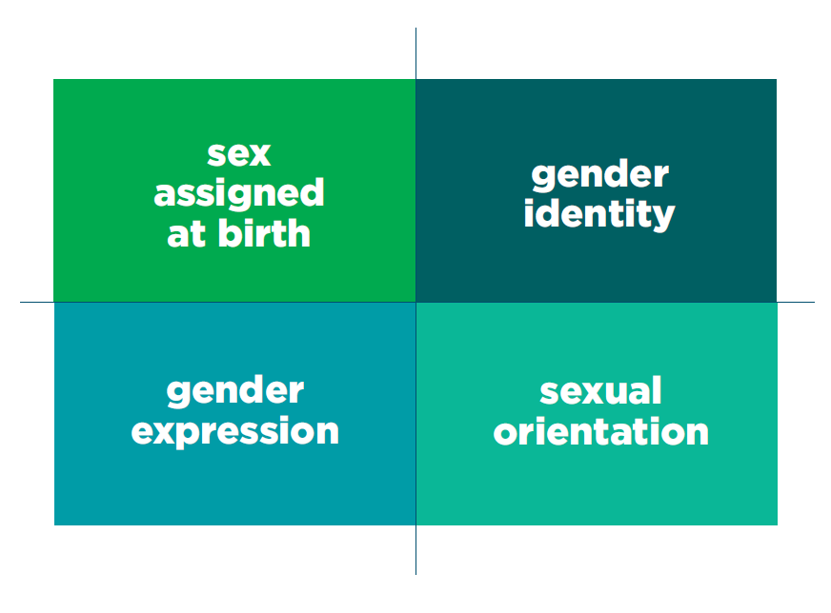
Notes:
Four core concepts that we’re going to keep in mind throughout the day. Ask Participants by a show of hands:
How many of you have a sex assigned at birth?
How many of you have a gender identity?
How many of you have a gender expression?
How many of you have a sexual orientation?
Main point: All of us (humanity) share these four core concepts. This isn’t unique to trans people however we may spend a little more time thinking about these four core concepts.

Slide 16
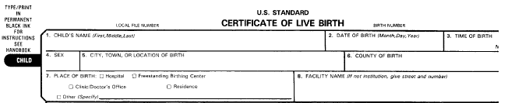
Sex Assigned at Birth
People are assigned one of two sexes at birth (or shortly after birth)
  Male
  Female
Notes:
Medically intersexuality is described as “Disorders of Sexual Development (DSD)”.
*

Slide 17

Key Terms
Gender Identity:
Internal sense of gender.
Gender Expression:
Outward expression of gender through gestures, behaviors, dress, etc.

Slide 18

Sexual Orientation
Includes:
Attraction
Behavior
Sexual Identity
Does NOT include gender identity or gender expression
Notes:
Canadian gay penguins!
Sexual orientation is the emotional and sexual attraction one feels for others, however, people may behave or define themselves sexually in complex ways. Some of these dimensions include sexual attraction, behavior and identity.
1. Attraction refers to the gender(s) a person is attracted to. And, this does not always align with behavior or identity. The desire to be with someone may never be acted upon and may not conform with someone’s sexual self-identity.
2. Behavior refers to the gender(s) of a person’s sexual and romantic partners.
3. Sexual Identity refers to how a person self defines or labels their sexuality. These labels may include lesbian, bisexual, straight, asexual, polysexual.
Although some people’s sexual identity aligns with their behavior, this is not always the case. Some women who identifies as lesbian have female and male partners. Some people who identify as heterosexual have same-sex partners.
And, all of these categories can be fluid – sexual behavior, identity and attraction can change over time based on an individual’s developmental stage, or cultural environment.
Sexual orientation and gender identity or gender expression are SEPARATE concept. Transgender refers to a person’s gender identity and expression, not to the gender(s) to which they are attracted. So, as with anybody, a transgender person can be gay, straight, bisexual, asexual, polysexual, etc. etc. etc.
*

Slide 19

Transgender
An umbrella term used to describe people whose gender or gender expression is different than the sex they were assigned at birth.
Notes:
Say, Transgender (or trans) is an umbrella term used to describe people whose gender identity or gender expression is different than the sex they were assigned at birth.
Since trans people may prefer and identify with certain terms under the transgender umbrella and not others, it is best to ask them what they prefer.
For this training, we use the term “transwomen” to refer to people who identify along a feminine spectrum of gender who were assigned a male sex at birth instead of “MtF” or “male-to-female.” We do so because language shifts over time and identity terms are culturally and regionally specific.
We use the term “transmen” to refer to people who identify along a masculine spectrum of gender who were assigned a female sex at birth instead of “FtM” or “female-to-male.”
People whose gender or gender expression is aligned with the sex they were assigned at birth are often referred to as “cisgender.” To keep things simple in this training, we will use the term “non-trans” rather than cisgender.
For all of these terms, we recommend that you mirror the language that your client uses. Also, some may define their gender outside of the binary construct of just male or just female. Some might not choose to define themselves by any gender, or some may feel that gender cannot be restricted by just two categories of male and female.
A key point here is that across cultures there may be very different understandings of gender identity. Learn the terms used in your community and respect what terms people use to self-identify.
*

Slide 20

Epidemiology of HIV/AIDS Among Trans People

Slide 21


Slide 22
Barriers to Health Care

Slide 23
Challenges in Data Collection
No population-based studies yet conducted
Lack of gender variance variables in health surveys
Social stigma
“Post-transsexual” identity and stealth existence
Trans female centric
Trans male invisibility
Pathology based

Slide 24
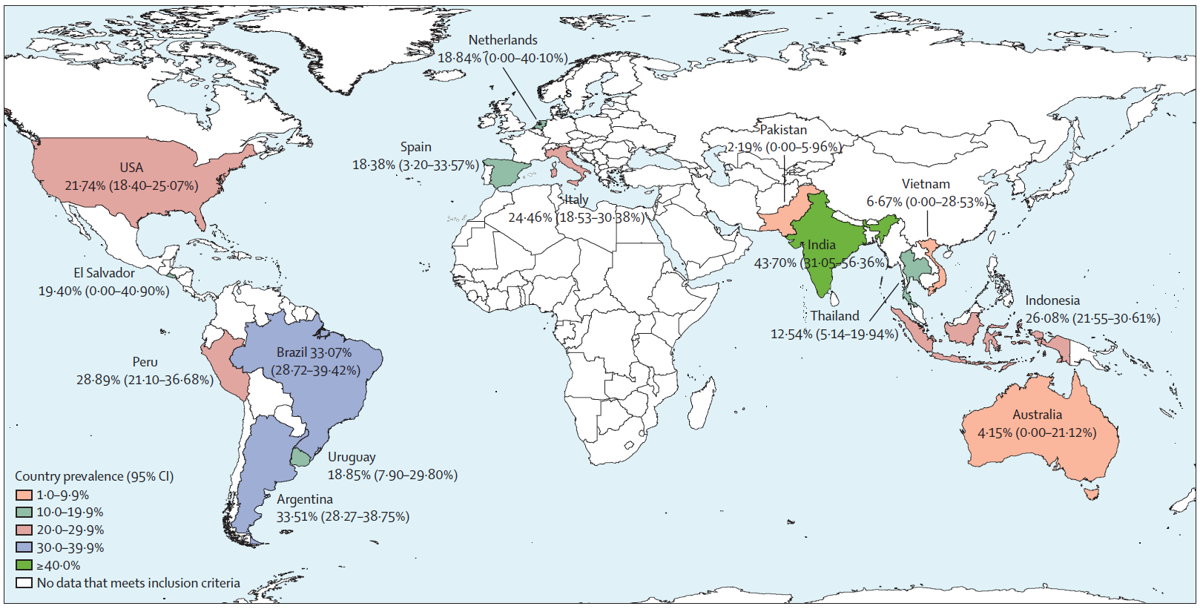
Worldwide burden of HIV in transgender women: a systematic review and meta-analysis
(Stefan D Baral, Tonia Poteat, et al; Lancet Infect Dis 2013; 13:214-22
Notes:
15countries including USA, six Asia-Pacific countries, five in Latin America, and three in Europe. N= 11,066 transgender women
HIV prevalence was 19·1%
The odds ratio for being infected with HIV compared with all adults of reproductive age across the countries was 48·8 (95% CI 21·2–76·3) and participants were;
Less likely to have access to and utilization of HIV services.

Slide 25
Trans HIV Prevalence
North America
28%
United States (Herbst et al., 2008)
Meta analysis
0-3%
United States (Sevelius et al., 2010)
Trans men
Average self-report by transwomen was 12%

Slide 26
Research shows (n=6450):
28% of postponed necessary medical care when sick or injured.
19% were refused care due to their gender identity.
28% were subjected to harassment in a medical setting.
2% were victims of violence in the doctor’s office.
50% reported having to teach their medical providers about trans health care.
1% reported being attacked in the ER.
33% delayed or did not try to get preventive health care.
Injustice at Every Turn – 2011 – The Task Force and NCTE

Slide 27
Social Determinants of Health in Trans Communities
Multilayered
Complex
Social
Systemic
Poor Health Outcomes
Our health starts where we live, learn, work and play…
-Jane Isaacs Lowe, Ph.D.,
Vulnerable Populations Portfolio, Robert Wood Johnson Foundation
HIV
Housing
Employment
Violence
Mental Health
Incarceration
Education
Discrimination
Social Support
Substance Use
Stigma
Medical transition
Abuse
Care
Self harm
Trauma
Poverty
Notes:
Talk about why trans health
Barry will cover local epi and health related outcomes

Slide 28
Best Practices
Notes:
, now that we have a better understanding of HIV risks and rates among transgender individuals, and the social determinants that drive those risks, let’s see how we can improve our level of competency in working with transgender people.

Slide 29
Best Practices for Transgender HIV Prevention
1. Ground your work in the Community
2. One size does not fit all
3. Use Multidisciplinary Approaches
4. Get the Facts
5. Look in All the Right Places
6. Increase Access to Health Care
7. Staff Development
8. Advocate

Slide 30

Trans-Affirming Health Care
  Train all staff
    Reception
    Medical providers
    Maintenance
    Security

Slide 31

Trans-Affirming Health Care
  Utilize the Primary Care Protocols for Transgender Patient Care
www.transhealth.ucsf.edu

Slide 32
Trans-Affirming Health Care

Slide 33
Two-Step Data Collection Recommendation
Update all intake forms
  What is your gender identity? (Check all that apply)
    _ Male
    _ Female
    _ Trans Male/Trans Man
    _ Trans Female/Trans Woman
    _ Genderqueer
    _ Additional Category (Please Specify): ____________
    _ Decline to State
  What sex were you assigned at birth?
    _ Male
    _ Female
    _ Decline to State

Slide 34

Acknowledging Sex and Gender
  Staff/Partner Training
    Acknowledging Sex and Gender Course
www.transhealth.ucsf.edu

Slide 35
Good Treatment Practices
Use proper pronouns with all clients
Get clinical supervision if you have issues or feelings about working with trans individuals.
Accommodate trans clients desire/need to continue the use of hormones
Guide trans clients using “street” hormones to obtain competent medical care

Slide 36

Additional Resources
Best Practices
Data Collection Recommendations
Primary Care Protocols
Latest Trans Research
Trans Health Information
Tool Kits
  CATCH
  NTHTD

Slide 37


www.transhealth.ucsf.edu
danielle.castro@ucsf.edu
www.facebook.com/transhealth
Notes:
The last page always has our website and facebook page

Slide 38
DC B21-168 - LGBTQ Cultural
Competency Continuing Education Amendment Act of 2015
Alison Gill, Esq., Senior Partner at The Parallax Group
Alisonmgill@gmail.com

Slide 39
Agenda
Why is cultural competency important for LGBTQ health?
  Cultural competency & LGBTQ health disparities
  Expanding trans coverage & lack of knowledgeable providers
What will the new DC law do?

Slide 40
Why is Cultural Competency Important for LGBTQ Health?

Slide 41
What is Cultural Competency?
Cross et al. (1989) originally defined cultural competence as “a set of congruent behaviors, attitudes, and policies that come together in a system, agency, or among professionals and enable that system, agency, or those professionals to work effectively in cross-cultural situations.”
Cultural competency is defined as the awareness and adequate responsiveness to patient populations with cultural factors that may affect health care, including language, beliefs, attitudes, and behaviors of health care providers. (Betancourt et al., 2002).

Slide 42
LGBTQ Health Disparities
LGBTQ people face healthcare disparities that result directly and indirectly from systemic stigma, minority stress, and discrimination.
HIV and
STIs
Depression,
Drug Use,
and
Suicide
Victimization
and Intimate
Partner
Violence

Slide 43
LGBTQ Health Disparities
Cultural competency is critical to reducing the healthcare disparities for all LGBTQ individuals and improving access to high-quality healthcare for LGBTQ individuals that is respectful of and responsive to their needs.
Necessary
Medical
Screenings
Self-
Treatment
or
Medication
Seek
Medical or
Mental
Health Care

Slide 44
LGBTQ Health Disparities
An IOM report on the Health of LGBT People (2011) noted that “a number of structural barriers result from providers’ lack of training in the health needs of LGBT patients.” Specifically, “many providers are not trained to provide care for LGBT individuals, and providers themselves report a lack of knowledge about the issues facing their sexual- and gender-minority patients.”
According to a 2009 survey by Lambda Legal, more than half of LGBTQ respondents (n = 4916) experience: being refused needed care; healthcare professionals refusing to touch them, using excessive precautions, or harsh/abusive language; being blamed for their health status; or healthcare professionals being physically rough/ abusive.
Notes:
The Joint Commission. ADVANCING EFFECTIVE COMMUNICATION, CULTURAL COMPETENCE, AND PATIENT- AND FAMILY-CENTERED CARE FOR THE LESBIAN, GAY, BISEXUAL, AND TRANSGENDER (LGBT) COMMUNITY: A FIELD GUIDE (2011).
American Association of Medical Schools. IMPLEMENTING CURRICULAR AND INSTITUTIONAL CLIMATE CHANGES TO IMPROVE HEALTH CARE FOR INDIVIDUALS WHO ARE LGBT, GENDER NONCONFORMING, OR BORN WITH DSD: A RESOURCE FOR MEDICAL EDUCATORS (2014).

Slide 45
General Lack of LGBTQ Training
Healthy People 2020 describes a shortage of health care providers who are culturally competent in LGBTQ health, a major system-level characteristic that affects equitable health care access for LGBTQ individuals.
A study of academic faculty practices (Khalili et al., 2015), found that:
Only 4.4% had a policy to identify LGBTQ-competent physicians
15.9 % offered comprehensive LGBTQ-competency training
52.2% had no LGBT components in training
LGBTQ-competency training in medical and professional schools continues to be very limited. 70% of surveyed deans rated their school’s curriculum “fair” or worse in this area (Obedin-Maliver et al., 2010).

Slide 46
Is LGBTQ Cultural Competency Training Effective?
Research on cultural competency training shows that:
One of biggest barriers to LGBTQ training is lack of formalized expectations for providers. Creates implicit message that this training is optional and not needed.
          Cultural competency training has been demonstrated to increase health care provider knowledge and awareness, and to improve communication skills.
          Health care provider cultural competency has been established to change physician behavior, which leads to improved patient outcomes.
          Providers report that discomfort in asking questions regarding transgender issues and discussions related to sex were a significant barrier to working with LGBTQ patients.
          Providers reported that learning about barriers to care put them in a position to better advocate for LGBTQ patients.
          Trainings are most effective when accompanied by system-wide change.

Slide 47
Increasing LGBTQ Health Coverage and Awareness
There have been advancements in healthcare coverage for LGBTQ people, but training for medical providers has not kept up.
DC is one of 16 jurisdictions that requires insurance coverage for transition-related care
Non-discrimination law in DC applies to medical providers and covers LGBTQ people
More states’ Medicaid provides trans-inclusive coverage
More states are providing employees with trans-inclusive coverage

Slide 48
Lack of Access to Providers
Although trans health coverage is increasing, there is a lack of providers and systems.
Very few providers of transition-related surgery, and many do not take insurance
No accreditation of training for trans-related medical services, nor is there certification of expertise in trans medicine
SOC for trans healthcare is non-binding
Obstacles to payment for trans-related services

Slide 49
What Will the New
DC Law Do?

Slide 50
DC LGBTQ Cultural Competency Continuing Education Amendment Act
Amend any existing continuing education requirements for licensed clinical healthcare providers in the District to include two credits of instruction on cultural competency or specialized clinical training focusing on LGBTQ patients.
Operates based on licensing cycle of profession
Does not require any additional continuing education credits
Licensing boards define appropriate instruction
Non-clinical are practitioners and professions are exempt

Slide 51
Examples of Training from DC Law
Required training may include:
Specialized clinical training relevant to LGBTQ patients
Training re relevant data concerning health disparities and risk factors for patients who identify as LGBTQ
Training that outlines the legal obligations associated with treating patients who identify as LGBTQ
Best practices for keeping confidential information re sexual orientation and gender identity
Best practices for training support staff re LGBTQ patients
Training that improves the understanding of the intersections between systems of oppression and discrimination
Training that addresses underlying cultural biases to provide non-discriminatory care for patients who identify as LGBTQ

Slide 52
What Comes Next?
LGBTQ defined as “patients who identify as lesbian, gay, bisexual, transgender, gender nonconforming, queer, or question their sexual orientation or gender identity and expression”
Law affects 33 licensed healthcare professions in DC
In the next stage, the District Dept. of Health will need to issue regulations and the professional boards will need to approve qualified trainings
In NJ, required cultural competency training for physicians increased participation in HHS Office of Minority Health cultural competency training nearly 60-fold, from 156 physicians to 9,078 physicians after 1 year

Slide 53
Legal Tools for Addressing Discrimination Against Transgender People in Health Care Settings
Omar Gonzalez-Pagan
Staff Attorney
Lambda Legal Defense and Education Fund, Inc.

Slide 54
Contents
What Are the Issues?
  Barriers to Health Care
  Discrimination
  Sex-Specific Medical Care
  Transition-Related Health Care
Legal Tools
  Affordable Care Act and Other Federal Laws
  State Non-Discrimination Laws
  State Insurance Bulletins

Slide 55

Issues Faced by Transgender
People in Health Care
Barriers to health care
Discriminatory treatment by health care professionals
Denial of sex-specific medical care
Denial of coverage for gender transition-related health care
Notes:
While LGBT people as a whole are insured at lower percentages than the overall American population, transgender individuals are uninsured and underinsured to an ever greater extent and frequently are denied coverage and access to quality care specifically because of their transgender status.
(http://www.iom.edu/Reports/2011/The-Health-of-Lesbian-Gay-Bisexual-and-Transgender-People.aspx)
(http://transgenderlawcenter.org/issues/health/transgender-health-and-the-law-identifying-and-fighting-health-care-discrimination)
*link from the HHS is incorrect*
*should I add what the third bullet means in this slide’s notes?
Will go into further detail on the following slides

Slide 56

Barriers to Care
Limited income & underinsured
Lack of trained professionals
Lack of mental health services
Notes:
Barriers to care: concerns about one’s ability to obtain needed care (as a TGNC person).
Barriers to care can lead to a reluctance to seek care, and as a result, poorer health outcomes.
More than other groups, TGNC respondents experience alienation from the health care system. Nearly 90% of the TGNC respondents experienced one or more barriers to care.
First Bullet: From When Health Care Isn’t Caring, 7% of the TGNC community have no income at all, 25% have an annual household income of under $20,000, 16% are uninsured or underinsured, over 9% use the emergency room as their usual source of care or have no usual source of care; 11% use public clinics; 9% use LGBT-specific clinics; 59% use private doctors
Second bullet: 89% are concerned that there are not enough health care professionals who are adequately trained to care for TGNC people. 73% believe that will be treated differently by health care professionals because of their gender identity or expression. 52% are concerned about being refused services.
Third bullet: 51% believe that there are not enough mental health support groups and 59 percent believe that there are not enough substance abuse providers with specific knowledge of transgender issues

Slide 57

Discrimination
  70 percent of TGNC people reported experiencing health care discrimination or harassment.
  Even higher rates for people of color.
  Inappropriate behavior from medical professionals
  Denial of (emergency) medical care
Notes:
First bullet: Lambda Legal’s 2009 survey, When Health Care Isn’t Caring, was the first survey to examine experiences with refusal of care and barriers to health care access among LGBT and HIV communities on a national scale. 617 people identified as TGNC.
Examples include being refused care (27%), being subject to harsh or abusive language by health care providers (nearly 21%), experiencing the refusal of providers to touch them, or the use of excessive precautions during treatment (over 15%), being blamed for the medical problem for which they sought care (20%), or being subjected to physically rough or abusive treatment by providers (almost 8%). 57% had been refused specific transgender health services, 21% were denied needed sexual health services, 15% were denied needed fertility services,
Second bullet: The National Transgender Discrimination Survey (the NTDS) of 2011 also revealed widespread disparities in transgender health care. Of over 6,000 transgender individuals who responded, 19 percent reported having been refused health care due to their transgender or gender non-conforming status. In addition, 28 percent had postponed necessary health care when sick or injured and 33 percent had delayed or not sought preventive care because of prior health care discrimination based on their transgender status
Third bullet: Even when health care is not refused, the biased behavior toward transgender people by hospital staff – including physicians, nurses, allied health professionals, admitting and registration personnel, and security officers – creates a negative experience that discourages future care seeking. As reported in the community surveys, such behavior too often has included:
• Laughter, pointing, joking, taunting, mockery, slurs, and a wide variety of negative comments;
• Violations of confidentiality, regardless of HIPAA;
• Use of improper names and/or pronouns for patients;
• Exceptionally long waits for care;
• Inappropriate questions and/or exams, including needless viewing of genitals;
• Prohibitions of restroom use;
• Inappropriate room assignments;
• Malpractice and even physical assault.
Fourth bullet: Discrimination by individual practitioners is more than a matter of requesting different care providers; it can be a matter of life and death.

Slide 58

Sex-Specific Medical Care
Issues with gender markers & insurance coding
Denied coverage for preventative care
Denied coverage for treatment of sex-specific cancers and other diseases
Robert Eads
Notes:
Transgender people are regularly denied sex-specific healthcare. This includes preventative care such as prostate cancer screenings and gynecological exams, as well as treatment for sex-specific illness.
First bullet: This is partly a function of health insurance coding according to which sex-specific care is coded with a specific gender marker. When an individual needs care associated with a sex different from the gender coding of that person’s records, the coding does not match and often neither the insurer nor the care provider adjusts and responds appropriately to the patient’s needs. Insurers frequently claim that their systems simply cannot recognize two genders for one client, even though trans people commonly require health care needed by both sexes. As a result, transgender people are routinely denied insurance coverage for medically necessary care that does not correspond with the gender recorded in their documents.
Given the role of gender markers for securing coverage for sex-specific care, and the frequency with which transgender people cannot secure insurance at all once their transgender status is known, some who are insured are apprehensive about changing the gender marker on their insurance policy after they have transitioned. Others have attempted to change the gender marker on their health insurance records after fully transitioning but have been denied the ability to do so by their insurer. Still others have discovered that their gender marker has been changed without their knowledge by doctors or nurses acting on their own.
Third bullet: Discrimination in accessing sex-specific care extends beyond preventative care. Transgender people are also routinely denied health insurance coverage for treatment of sex-specific cancers and other diseases. Health insurers have used even a suspicion of transgender status to deny coverage of medical care.
Twenty-seven physicians refused to treat Robert Eads, a transgender man, for his ovarian cancer, a disease which initially was treatable but from which he eventually died. (Documentary Southern Comfort)

Slide 59
Gender Transition-Related Health Care
The AMA, APA, and other medical communities recognize the necessity of hormone therapy and gender-affirming surgery to treat gender dysphoria
Many health care providers continue to exclude coverage because of an outdated misconception
Many insurance companies are already providing coverage for transition-related health care, but will later deny the same treatment when connected to gender transition
Notes:
First bullet: Leading authorities in the medical and policy communities, including the American Medical Association and American Psychological Association, have recognized the medical necessity of hormone therapy and sex reassignment surgery (SRS) for some patients with gender dysphoria ** NOT ALL TRANS PEOPLE EXPERIENCE GENDER DYSPHORIA. IT IS AN INDIVIDUALIZED ASSESSMENT**
Second bullet: Yet, the historical exclusions of transition-related medical care such as hormone therapy and SRS remain in the health insurance contracts of the majority of public and private insurance companies – preventing coverage even when a doctor confirms the treatment is medically necessary for a patient. These exclusions generally were based on the now-outdated misconception that the treatments are experimental or cosmetic. Despite today’s settled medical consensus that this care is medically necessary for some patients, the exclusions remain common.
Although public support is growing rapidly, individuals with gender dysphoria who lack access to appropriate medical care may become desperate and engage in harmful self-treatment.

Slide 60
Legal Tools: Section 1557 of the Affordable Care Act
Section 1557 of the Affordable Care Act prohibits discrimination “on the basis of sex” in any health program or activity covered by the ACA.
In the proposed regulations, “on the basis of sex” is explicitly defined to include “sex stereotyping” and “gender identity.”
Other Federal Laws (Title VII, Title IX).

Slide 61
Examples of Section 1557 Enforcement
Rumble v. Fairview Health Services
  District Court of Minnesota (2015)
  The court held that “Section 1557 protects plaintiffs … who allege discrimination based on “gender identity.’”
Brooklyn Hospital Center
  HHS-OCR Administrative Enforcement
  Hospital entered into voluntary resolution agreement after OCR investigation on hospital’s treatment of transgender patients.
Notes:
Brooklyn Hospital Center in New York entered into a formal voluntary resolution agreement with OCR to ensure that transgender patients receive appropriate and equitable care and treatment. The agreement resolves a complaint filed by a transgender individual alleging discrimination on the basis of gender identity in the assignment of patient rooms. The agreement requires the hospital to revise its admissions policy to include prohibitions against sex discrimination. For example during the intake process, patients are provided an opportunity to identity their preferred name and gender/transgender status. The hospital has committed to revising its room placement policy to ensure the safe, ethical, appropriate, and nondiscriminatory assignment of rooms for transgender patients. Additionally, the hospital will implement policies and train staff to prevent and address derogatory statements and adverse treatment based on sex. OCR will monitor the hospital for two years.

Slide 62

Legal Tools: State
Non-Discrimination Laws
17 states and the District of Columbia prohibit discrimination based on gender identity in public accommodations.
New York covers discrimination on the basis of gender identity through regulations.

Slide 63
Legal Tools:
State Insurance Bulletins
15 states and the District of Columbia have issued regulatory guidance to insurance companies prohibiting discrimination on basis of gender identity in health insurance policies or contracts.
  The states are: CA, CO, CT, DE, IL, MA, MD, MI, MN, NY, NV, OR, RI, VT, and WA.
They are based on state and federal law requirements.
Notes:
DISCUSS O’CONNELL MATTER
The regulatory guidance makes clear that insurance providers cannot deny, exclude, or otherwise limit coverage for medically necessary treatment otherwise covered by a health insurance policy or contract based solely on an individual’s gender identity, expression or gender dysphoria.

Slide 64
Resources
Transgender Rights Toolkit
www.lambdalegal.org/trans-toolkit
Lambda Legal Help Desk (866-542-8336)
Publications:
  Creating Equal Access to Quality Health Care for Transgender Patients: Transgender-Affirming Hospital Policies
  When Health Care Isn’t Caring
  Health Care Rights and Transgender People
  Medicare Benefits and Transgender People

Slide 65
Thank you.
Omar Gonzalez-Pagan
Staff Attorney
Lambda Legal
120 Wall Street, 19th Floor
New York, New York 10005
Phone: 212-809-8585 Fax: 212-809-0055
E-mail: ogonzalez-pagan@lambdalegal.org

Slide 66

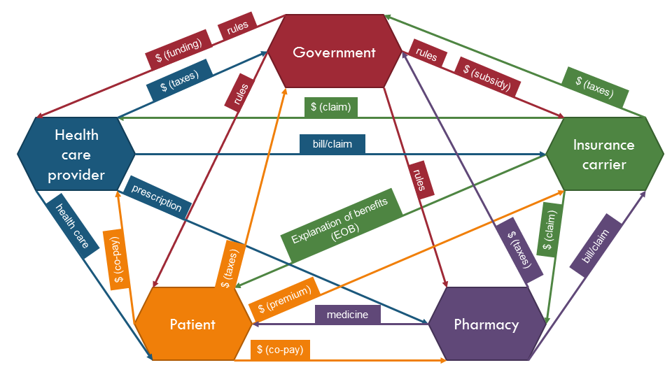
How to turn law and policy into practice
April 20, 2016
Anand Kalra
anand@transgenderlawcenter.org

Slide 67
Five types of system barriers
Cost of health care/health coverage
Denial of private insurance
  Pre-existing conditions
Exclusions of transition-related and gender-specific care
  Denials of care
Bureaucracy once you have coverage
Shortage of educated and/or in-network providers

Slide 68
Insurance Division Bulletins
State agency guidance to insurers about how to apply state law to the insurance plans offered
States have gender identity non-discrimination provisions, especially public accommodations laws
Applies to fully managed plans (not self-insured plans)
Notes:
AKA Directives

Slide 69
Implementation Concerns
New exclusions (e.g., labeling certain procedures “cosmetic”)
Shortage of trained providers (network adequacy)
Insufficient cultural competency
  Among humans
  In systems

Slide 70
The Patient-Provider-Payer Triangle
rules
Government
$ (funding)
rules
$ (taxes)
$ (subsidy)
$ (taxes)
rules
$ (claim)
Health care provider
Insurance carrier
bill/claim
rules
prescription
health care
Explanation of benefits (EOB)
$ (claim)
$ (taxes)
bill/claim
$ (co-pay)
$ (taxes)
Patient
$ (premium)
Pharmacy
medicine
$ (co-pay)
Notes:
Most advocacy happens in this triangle

Slide 71
The Patient-Provider-Payer Relationship
$ (claim)
Health care provider
Insurance carrier
bill/claim
$ (co-pay)
Explanation of benefits (EOB)
health care
Patient
Each time you have a doctor visit, the doctor’s office sends a bill to the insurance company. The bill includes a diagnosis code and a procedure code for everything that happened – throat swab, blood test, check-up.

Slide 72
The Patient-Provider-Payer relationship
$ (claim)
Health care provider
Insurance carrier
bill/claim
$ (co-pay)
Explanation of benefits (EOB)
health care
Patient
The insurance carrier (or plan administrator) then checks the bill to make sure the diagnosis codes and procedure codes line up correctly. If everything looks good, the doctor gets a check and you get an Explanation of Benefits (EOB) detailing the costs and how much you owe after the insurance pays its part.

Slide 73
Down the Insurance Rabbit Hole
Example:
  Diagnosis: broken leg
  procedure code: bone-setting
  Computer says: Ok!
  Result: send payment to doctor and EOB showing allowed amount
Example
  Diagnosis: broken leg
  Procedure code: removal of lung
  Computer says: no way!
  Result: no payment and send EOB explaining why claim denied

Slide 74
With trans exclusions…
Even if a plan has no exclusions for transition-related care, you may still receive a claim denial
  Why? No one told the computer.
Example:
  Diagnosis code: 302.85 (Gender identity disorder)
  Procedure: mastectomy
  Computer says: no way!
  Result: claim denial

Slide 75
National Coalition for LGBT Health
Ryan Meyer, ryan@healthlgbt.org,202.507.4735
www.healthLGBT.org

Slide 76
How to Obtain Credit
Please go online to CME University at: www.cmeuniversity.com, and register or login (takes less than 1 minute).
Once logged in, follow these steps:
1. Click on the “Find Post-Test/Evaluation by Course:” at the top of the page.
2. Type in “11669” and hit enter.
3. Click on the activity title when it appears.
4. Choose your profession/type of credit you are seeking.
5. Complete the online Evaluation Form.
Upon completion of the online Evaluation form, you will have immediate access to a certificate of attendance to print or save for your files.
If you have any questions regarding the CE certification for this activity, please contact Postgraduate Institute for Medicine at: information@pimed.com or (303) 799-1930.

Slide 77


